Slide 1

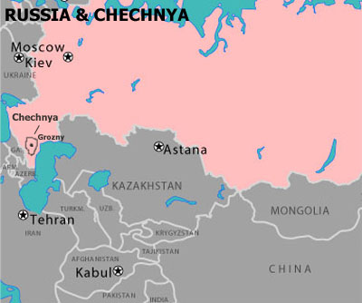
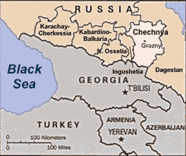
Chechnya: an oil rich Islamic break away Republic in the Caucuses Region

Slide 2
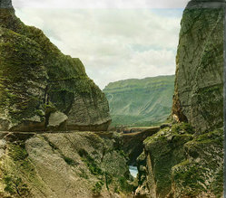
History:
1858 - After decades of violent resistance, Chechnya is conquered by Russia following the defeat of Imam Shamil and his fighters, who had aimed to establish an Islamic state.
1944 - Soviet dictator Stalin deports the entire Chechen and Ingush populations to Siberia and Central Asia, citing alleged collaboration with Nazi Germany. Many thousands die in the process.
1991 - Collapse of the Soviet Union. Communist leader Doku Zavgayev overthrown; Dzhokhar Dudayev wins a presidential poll and proclaims Chechnya independent of Russia.
1992 - Chechnya adopts a constitution defining it as an independent, secular state governed by a president and parliament. But the pipelines that cross it, and its different Constitutional status means Russia won’t let it go
1994 December - Russian troops enter Chechnya to quash the independence movement. Up to 100,000 people - many of them civilians - are estimated to have been killed in the 20-month war that followed.

Slide 3
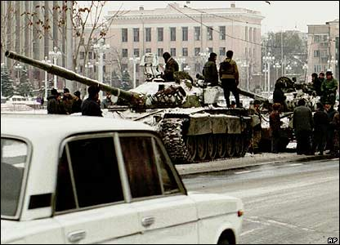
“we need a short and victorious war”
Russia launched massive air strikes on the Chechen capital, Grozny, in December 1994 after the Chechen government refused to disarm and surrender to Moscow's authority.
Tanks rolled in on 11 December, their paths often blocked by peaceful protests. By the end of the month they had reached Grozny.
The first bloody battle took place on New Year's Eve and was a disaster for the Russian forces. Hundreds of soldiers died.

Slide 4
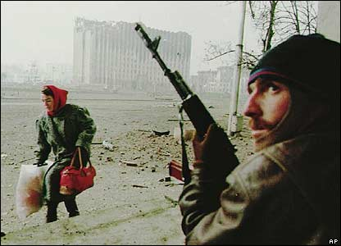
Battle for Grozny
The fight for control of Grozny continued for weeks.
Russian forces' air strikes and artillery demolished large parts of the city centre.
Chechen fighters used guerrilla tactics to harass the Russian forces and their armour.
Thousands of Chechens fled their homes, filling up refugee camps in neighbouring Ingushetia

Slide 5
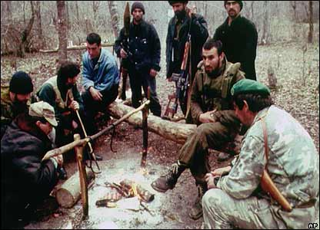
The Chechen rebels made good use of the mountain terrain.
They used forested hillsides for cover, and for mounting ambushes.
They could also rely on considerable public support.
In 1996, they came down from the hills and regained control of Grozny, forcing the Russian authorities to make peace.
The rebels' military commander, Aslan Maskhadov, was elected president in January 1997

Slide 6
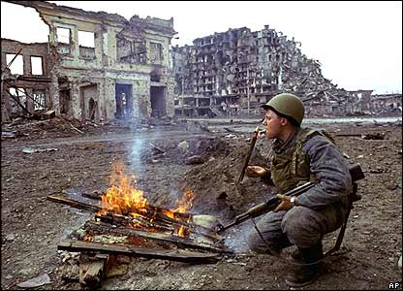
Yeltsin described his decision to send the army into Chechnya at the end of 1994 as his greatest mistake. The aim was to restore Moscow's authority over the unruly and crime-ridden North Caucasus. The result was a disaster. In 21 months of fighting thousands of civilians died, many thousands more were made homeless and the centre of the capital, Grozny, was reduced to rubble. In 1996 the Russian army was forced into a humiliating withdrawal, leaving Chechnya as a de facto independent territory in the hands of violent warlords. Four years later, battle was resumed, when Russian forces were ordered back into the breakaway republic.

Slide 7
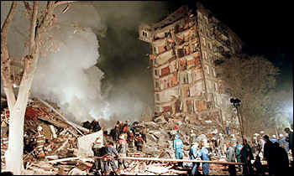
August and September 1999. A series of apartment-block bombs brought terror to Russian cities, killing nearly 300 people in The attacks came as Russian troops drove Islamic insurgents from Chechnya out of the neighbouring North Caucasian republic of Dagestan. Soon afterwards Russia sent thousands of troops into Chechnya itself to smash the guerrillas. This time the war proved popular with the Russian public who voted in large numbers for the pro-Kremlin Unity party, backed by Prime Minister Vladimir Putin, in December's parliamentary election.

Slide 8
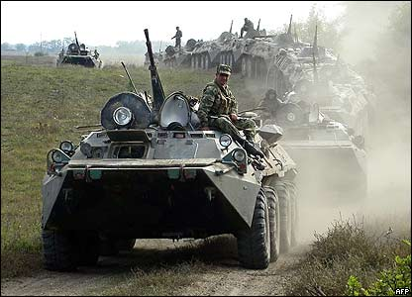
So the war takes a “Round TWO”
The Russian army stormed back into Chechnya in autumn 1999, on the orders of Vladimir Putin. Chechen radicals were blamed for a series of apartment block bombings. They also tried to start an Islamist rebellion in neighbouring Dagestan.
The region had also become one of the world's hostage-taking capitals. As President Maskhadov was challenged by a number of rebellious warlords, the republic slipped out of his control.

Slide 9
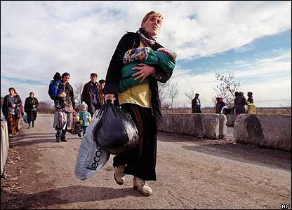
Once more, Chechen civilians were the worst hit. Thousands streamed back into the camps in Ingushetia.
Families were divided or left fatherless. Already a generation was growing up in the shadow of war.

Slide 10
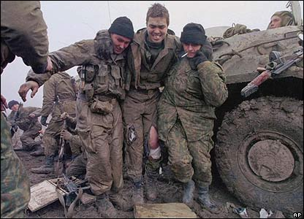
The number of Russian casualties is unknown.
The Russian authorities rarely publish figures.
The Committee of Soldiers' Mothers has estimated that 12,000 died between autumn 1999 and autumn 2003.
Many of those sent to fight in Chechnya were raw recruits, poorly trained and equipped - and sometimes poorly fed.
Many civilians have also died

Slide 11
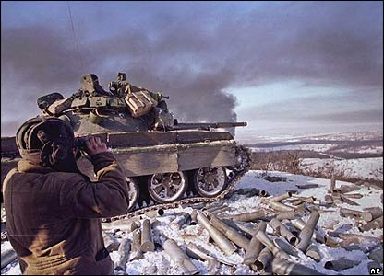
Russian tanks continued to rain shells down on Grozny, in the months after the second invasion.
More cautious than in 1994, troops advancing into the city pulled back whenever they encountered resistance.
The area would then be pounded by artillery.

Slide 12
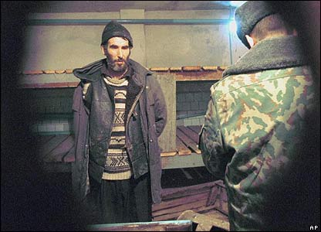
Russian forces have been accused of persistent human rights violations.
Their tactic of indiscriminately rounding up Chechen men of fighting age, then interrogating them in "filtration camps" in order to identify rebel fighters has been widely condemned.
Many Chechen men have "disappeared" in this way. The Russian human rights group Memorial has said 194 Chechens disappeared in the first half of 2004.
4
4
4
Western criticism of Russian tactics and human rights violations in Chechnya was all but silenced following the 11 September attacks on the US. Russia has since portrayed the Chechens as part of the global terror network and uses this to vindicate its methods

Slide 13
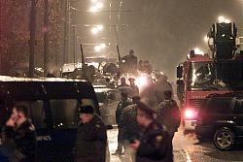
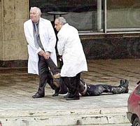
Special forces and Interior Ministry troops taking up positions around the theater, which was seized Wednesday by a group of armed men during a performance of "Nord-Ost."
2 doctors remove body of female hostage taker
Fall 2002 Chechen rebels seize theatre—rescue is a fiasco; over 100 people died from the effects of toxic knockout gas sprayed by security forces into a central Moscow theater, where Chechen fighters - including 19 female shakhidy, or "martyrs" - were holding 800 hostages

Slide 14
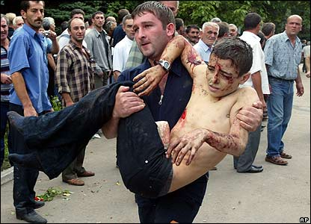
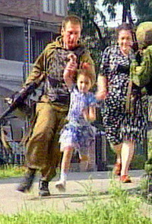
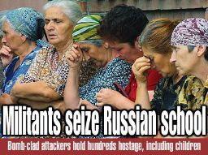
The bloodiest rebel atrocity took place at a school in Beslan, North Ossetia, in 2004. Rebels seized the school on the first day of the autumn term, with more than 1,000 pupils, parents and teachers inside.
The siege ended in a bloodbath, in which more than 330 people died

Slide 15
Summer 2003 Sixteen died when two women shakhidy blew themselves up at a Moscow rock concert in July
Dec 2003 alleged Chechen suicide bomber killed 44 people on a commuter train in southern Russia. Responsibility for such bombings is seldom claimed by Chechen rebels or anyone else
Dec 2003 A suicide bomber detonated a powerful explosive belt near Russia's key symbols of power Tuesday, killing six people and injuring 12 just a few steps from Red Square, the Kremlin and the State Duma
Feb 2004 devastating terrorist attack on a crowded Moscow metro train Friday, killed at least 39 commuters and injured 122, has ratcheted up public fear and tensions on the eve of Russia's long-awaited presidential election. The apparent suicide bombing, blamed by authorities on Chechen rebels, seemed to echo the horrifying autumn of 1999, when a series of still-unsolved apartment explosions killed almost 300 people just as Russia was headed into the cycle of parliamentary and presidential elections that brought Vladimir Putin to power.

Slide 16
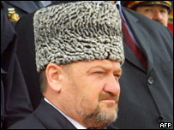
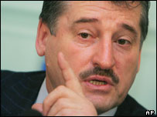
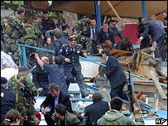
A controversial referendum in March 2003 approved a new constitution, giving Chechnya more autonomy but stipulating that it remained firmly part of Russia. Akmad Kadryov elected president; then killed by a bomb attack in a stadium.
President Kadyrov: Assassinated in 2004
New Kremlin backed president : Alkhanov
People fled from the scene in terror
Notes:
http://news.bbc.co.uk/2/hi/europe/3697715.stm

Slide 17
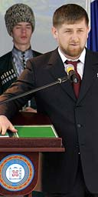
Former rebel sworn in as new president of Chechnya April 5, 2007
A 30-year-old amateur boxer who is accused by human rights groups of murdering and kidnapping civilians was this morning inaugurated as the new president of the war-torn republic of Chechnya.
Ramzan Kadyrov, a former rebel turned Moscow loyalist who has his own militia army, was installed as president in a lavish ceremony in Gudermes, Chechnya's second-largest city, 20 miles east of the capital, Grozny. Human rights groups allege that security forces under Mr Kadyrov's control abduct and torture civilians suspected of ties to Chechnya's separatist rebels. Some observers also suggest he was behind last year's murder of Anna Politkovskaya, the investigative journalist who had documented Chechnya's plight.
Mr Kadyrov denies involvement. Her killers have not been caught. This morning hundreds of high-profile guests gathered to see Mr Kadyrov presented with the Chechen flag and coat of arms.
.
The new Chechen president, Ramzan Kadyrov, takes the oath in the Chechen town of Gudermes
Moscow has poured huge funds into rebuilding Grozny and Chechnya, and insists that the region has now returned to normal. Mr Kadyrov has taken much of the credit for this. Large posters with his picture and streets named after both him and his father have helped create a personality cult.
"I've been coming here and working here on and off for five years," Pavel Tarakanov, 25, the head of Moscow-based Civil Society group told Reuters news agency this morning. "But in the last half a year Kadyrov has changed Chechnya beyond all recognition."
With help from Mr Kadyrov's militias, Russian forces have wiped out most insurgent leaders and driven the rebels into mountain hideouts from where they launch occasional attacks
Notes:
The stocky, bearded Kadyrov has always denied allegations of rights abuses. He became prime minister in the region's pro-Moscow administration last year and took over as president-designate in February.

Slide 18
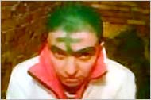
In Chechen’s Humiliation, Questions on Rule of Law
Since 2004, the war in Chechnya has tilted sharply in the Kremlin’s favor, as open combat with separatists has declined in intensity and frequency. Moscow now administers the republic and fights the remaining insurgency largely through paramilitary forces led by Ramzan A. Kadyrov, the powerful young Chechen premier.
Mr. Kadyrov’s public persona is flamboyantly pro-Russian. He praises President Vladimir V. Putin and has pledged to rebuild Chechnya and lead it back to the Kremlin’s fold. “I cannot tell you how great my love for Russia is,” he said in an interview this year.
http://www.nytimes.com/2006/08/30/world/europe/30chechnya.html?ex=1314590400&en=a381ae015710fb2d&ei=5088&partner=rssnyt&emc=rss
But beneath this publicly professed loyalty, some of Chechnya’s indigenous security forces — with their evident anti-Slavic racism, institutionalized brutality, culture of impunity and intolerant interpretation of a pre-medieval Islamic code — have demonstrated the vicious behavior that Russia has said its latest invasion of Chechnya, in 1999, was supposed to stop.

Slide 19
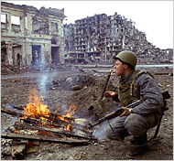
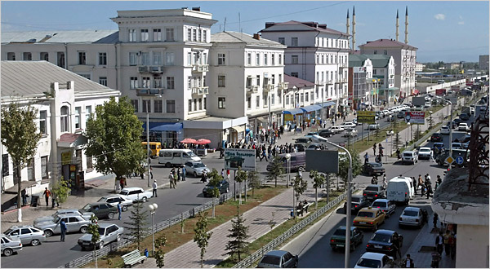
Chechnya now . . .
Grozny in 1995
Grozny, Chechnya’s capital, this year. Sept 30 2007

Slide 20
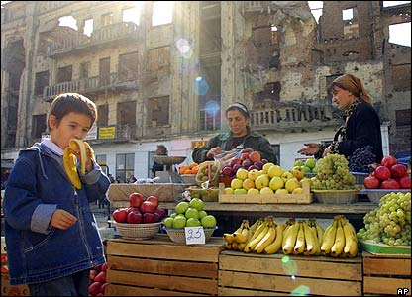
Life for some Chechens has begun to return to normal, despite sporadic car-bombs and assassinations, and continuing tensions between security forces and rebel sympathisers. Some reconstruction work has taken place. Many refugees have returned home.

Slide 21
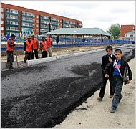
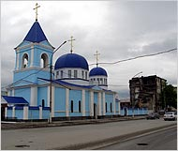
C.
A road in Gudermes is being surfaced and in the background
An Orthodox church rebuilt in Grozny, the capital of Chechnya, which was largely destroyed by years of war.

Slide 22
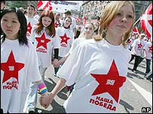
A new pro-Putin youth group has been formed recently

